Slide 1
BROWSER OBJECT MODEL
ANJU MUNOTH

Slide 2
Browser object model
All browsers are split into different parts (objects) that can be accessed using Javascript.
Collectively known as the Browser Object Model, or the BOM.
At the very top of the browser hierarchy is the Window object.Represents the entire browser, with its toolbars, menus, status bar, the page itself. Effectively, the Window IS the browser.
Below the Window Object there are lots of other objects you can access which allow you do things like, redirecting the user to a different web page, get the size of the browser window, access all the HTML elements on the page

Slide 3
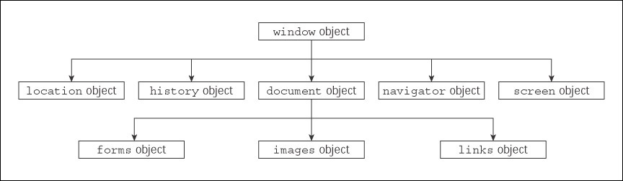
BROWSER OBJECT MODEL

Slide 4
BROWSER OBJECT MODEL
window.document
Allows you to access all your HTML elements.
window.history
Access information about browsing history. Access the methods history.back, history.forward and history.go.
window.innerHeight and window.innerWidth
Gets the height and width of the available space on the page
window.screen
Gets information about the browser screen

Slide 5
Window object
BOM is a pack of objects that allow to control the browser, e.g change current URL, access frames, do background requests to server with XMLHttpRequest etc.
Functions like alert,confirm,prompt also belong BOM, they are provided by the browser.
On the top is the window, also called global object.
All other objects form 3 groups.
The default object of browser is window. Can call all the functions of window by specifying window or directly

Slide 6
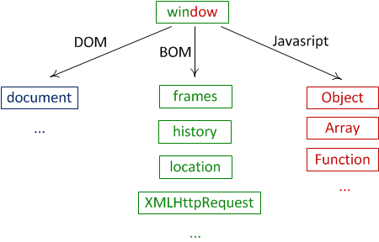
Window object

Slide 7
Window Object
Window Object
Properties of Window Object
Methods of Window Object
Example of Window Object
.

Slide 8
Window Object
The window object represents a window in browser. An object of window is created automatically by the browser.
Window is the object of browser, it is not the object of javascript. The window object is supported by all browsers. It represents the browser's window.
All global JavaScript objects, functions, and variables automatically become members of the window object.
Global variables are properties of the window object.
Global functions are methods of the window object.
Even the document object (of the HTML DOM) is a property of the window object:

Slide 9
Window Size
Two properties can be used to determine the size of the browser window.
Both properties return the sizes in pixels:
window.innerHeight - the inner height of the browser window (in pixels)
window.innerWidth - the inner width of the browser window (in pixels)

Slide 10
Methods of window object
window.open() - open a new window
window.close() - close the current window
window.moveTo() -move the current window
window.resizeTo() -resize the current window

Slide 11
Methods of window object
The important methods of window object are as follows:
Method | Description
alert() | displays the alert box containing message with ok button.
confirm() | displays the confirm dialog box containing message with ok and cancel button.
prompt() | displays a dialog box to get input from the user.
open() | opens the new window.
close() | closes the current window.
setTimeout() | performs action after specified time like calling function, evaluating expressions etc.

Slide 12
Example of open() in javascript
<script type="text/javascript">
function msg(){
open("http://www.google.com");
}
</script>
<input type="button" value=“Go To Google" onclick="msg()"/>
Example : javascript demos\windowopen.html
Example : javascript demos\windowdemo1.html

Slide 13
Example of setTimeout() in javascript
var displayArea = document.getElementById("id39018");
// conver number num to string, pad 0 in front to make it 2 digits
function format(num) {
var numStr = num.toString();
if (numStr.length === 1) {
return "0" + numStr;
} else {
return numStr; } }
function updateTimeDisplay() {
var dd = new Date();
var hh = dd.getHours();
var mm = dd.getMinutes();
var ss = dd.getSeconds();
displayArea.textContent = format(hh) + ":" + format(mm) + ":" + format(ss); }
setInterval(updateTimeDisplay, 1000);
Example: javascript demos\analogclock.html

Slide 14
JavaScript Window Location
window.location object can be used to get the current page address (URL) and to redirect the browser to a new page.
window.location object can be written without the window prefix.
Properties:
window.location.href returns the href (URL) of the current page
window.location.hostname returns the domain name of the web host
window.location.pathname returns the path and filename of the current page
window.location.protocol returns the web protocol used (http:// or https://)
window.location.assign loads a new document

Slide 15
JavaScript Window History
window.history object contains the browsers history.
window.history object can be written without the window prefix.
To protect the privacy of the users, there are limitations to how JavaScript can access this object.
Some methods:
history.back() - same as clicking back in the browser. loads the previous URL in the history list
history.forward() - same as clicking forward in the browser. loads the next URL in the history list

Slide 16
JavaScript Window Navigator
window.navigator object contains information about the visitor's browser.
window.navigator object can be written without the window prefix.
Properties:
navigator.cookieEnabled - returns true if cookies are enabled, otherwise false
navigator.appName //Netscape
navigator.appCodeName //Mozilla
appName and appCodeName return the name of the browser
navigator.product- returns the engine name of the browser //Gecko
navigator.appVersion - returns version information about the browser
navigator.platform - returns the browser platform (operating system) //win32

Slide 17
JavaScript Window Navigator
Properties:
navigator.language returns the browser's language
naviagator.javaEnabled() returns true if Java is enabled

Slide 18
cookies
Cookies let you store user information in web pages.
Cookies are data, stored in small text files, on your computer.
When a web server has sent a web page to a browser, the connection is shut down, and the server forgets everything about the user.
Cookies were invented to solve the problem "how to remember information about the user":
When a user visits a web page, his name can be stored in a cookie.
Next time the user visits the page, the cookie "remembers" his name
When a browser request a web page from a server, cookies belonging to the page is added to the request. This way the server gets the necessary data to "remember" information about users

Slide 19
cookies
JavaScript can create, read, and delete cookies with the document.cookie property.
Cookies are a plain text data record of 5 variable-length fields −
Expires − The date the cookie will expire. If this is blank, the cookie will expire when the visitor quits the browser.
Domain − The domain name of your site.
Path − The path to the directory or web page that set the cookie. This may be blank if you want to retrieve the cookie from any directory or page.
Secure − If this field contains the word "secure", then the cookie may only be retrieved with a secure server. If this field is blank, no such restriction exists.
Name=Value − Cookies are set and retrieved in the form of key-value pairs

Slide 20
Create a Cookie with JavaScript
Storing Cookies
To create a cookie is to assign a string value to the document.cookie object
document.cookie = "key1=value1;key2=value2;expires=date";
expires attribute is optional.Attribute takes a valid date or time as input,and cookie will expire on a given date or time and thereafter, the cookies' value will not be accessible

Slide 21
Create a Cookie with JavaScript
JavaScript can create, read, and delete cookies with the document.cookie property.
With JavaScript, a cookie can be created like this:
document.cookie = "username=John Doe";
Can also add an expiry date (in UTC time). By default, the cookie is deleted when the browser is closed:
document.cookie = "username=John Doe; expires=Thu, 18 Dec 2013 12:00:00 UTC";
With a path parameter, can tell the browser what path the cookie belongs to. By default, the cookie belongs to the current page.
document.cookie = "username=John Doe; expires=Thu, 18 Dec 2013 12:00:00 UTC; path=/";

Slide 22
Read a Cookie with JavaScript
With JavaScript, cookies can be read like this:
var x = document.cookie;
document.cookie will return all cookies in one string much like: cookie1=value; cookie2=value; cookie3=value;

Slide 23
Change a Cookie with JavaScript
With JavaScript, can change a cookie the same way as you create it:
document.cookie = "username=John Smith; expires=Thu, 18 Dec 2013 12:00:00 UTC; path=/";
The old cookie is overwritten

Slide 24
Delete a Cookie with JavaScript
Deleting a cookie is very simple. Just set the expires parameter to a passed date:
document.cookie = "username=; expires=Thu, 01 Jan 1970 00:00:00 UTC";
Need not specify a cookie value to delete a cookie.

